Slide 1
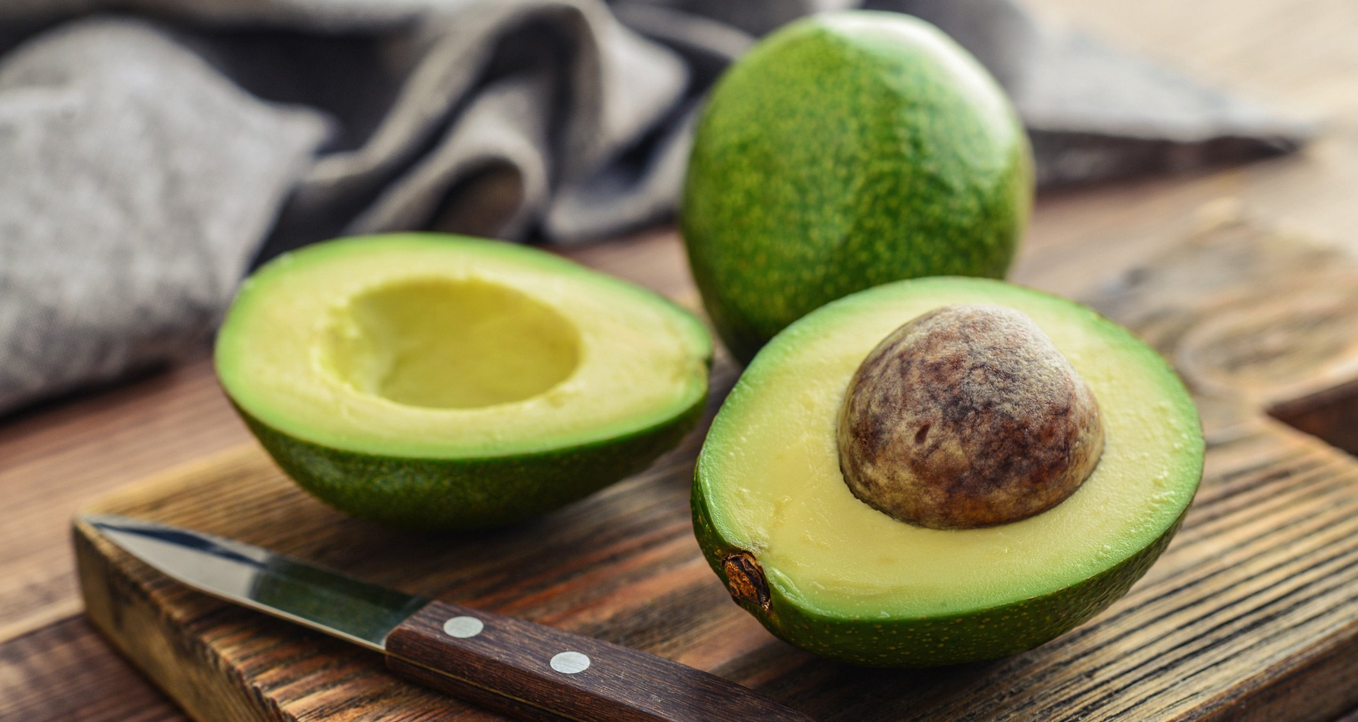
Avocado Demand Analysis
Allison Beatty
Joshua Ching
Ruyi Liang
Ian Scarff
Notes:
Allison

Slide 2
Data Overview
Original: (From Kaggle: Avocado Prices)
● Weekly Data (Jan. 4, 2015 - Mar. 25, 2018)
● Avg. Price
● Total Volume Sold
● Volume Sold per Type of Avocado
○ Small Hass, Large Hass, Extra Large Hass
● Growing Type
○ Conventional or Organic
● Region
○ 42 Metropolitan Areas
Notes:
Allison

Slide 3
Data Preparation
Add-On:
Total Revenue
Overall and Per Avocado Type
Geographic Information
Latitude and Longitude, State
Cost of Living Index
Notes:
Allison

Slide 4
Questions
Where are the most avocados sold & where are avocados most expensive on average?
What is the most popular type of avocado sold?
In which months is demand higher/lower?
What will the future demand and price be?
Notes:
Allison
Whys:
Q1: Avocado providers can identify where the majority of profits are coming from and where demand is higher.
Q2: Know what type of avocado to prioritize.
Q3: Helps providers strategize their logistics before and after harvesting.
Q4: Better enable avocado providers to maximize revenue and improve budget planning.

Slide 5
Demands
Notes:
Joshua

Slide 6
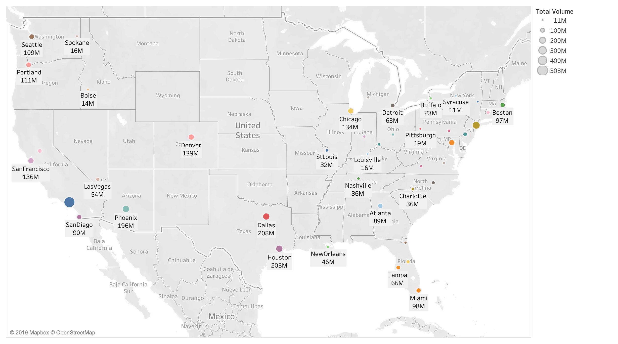
Notes:
Joshua
Overview of total volume (might be population)

Slide 7
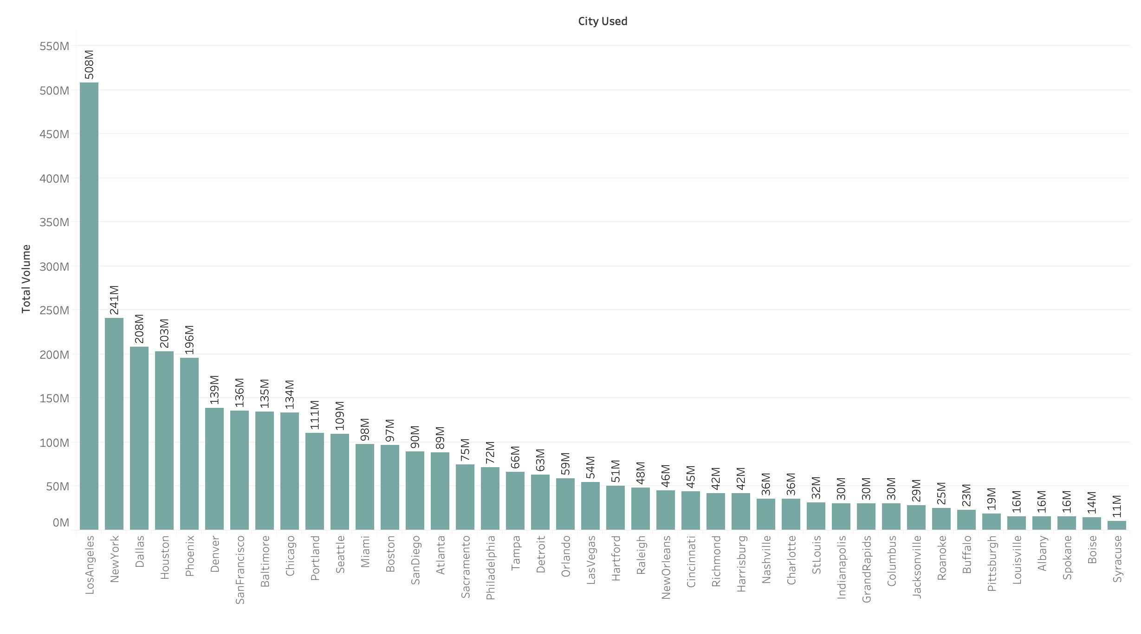
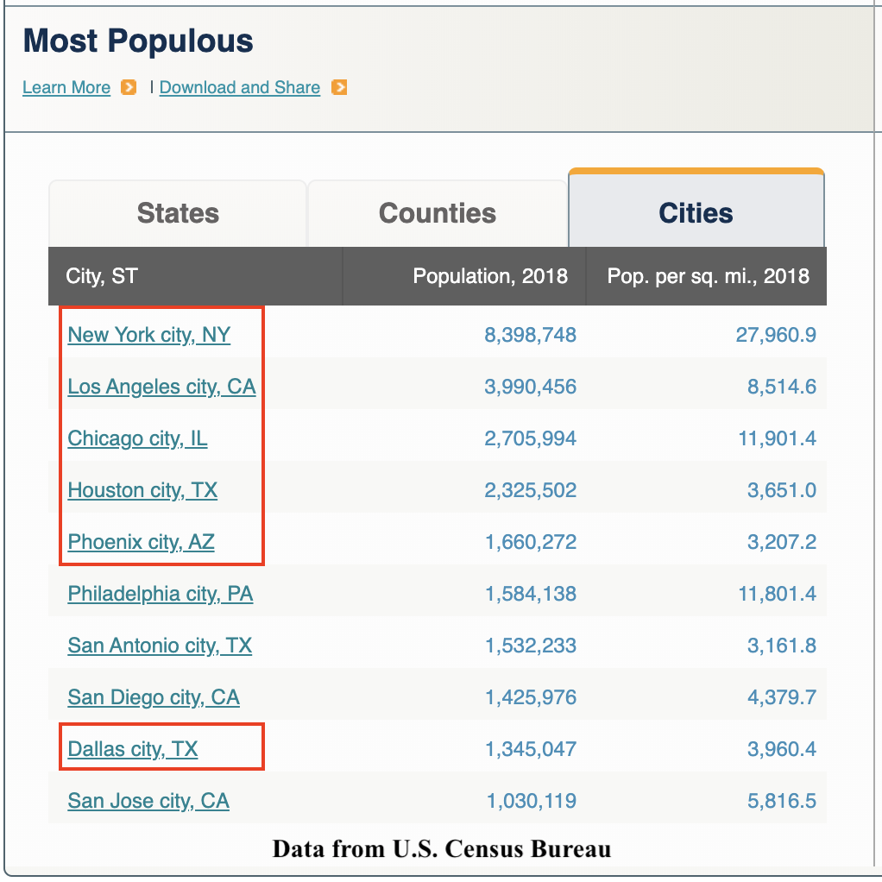
Notes:
Joshua

Slide 8
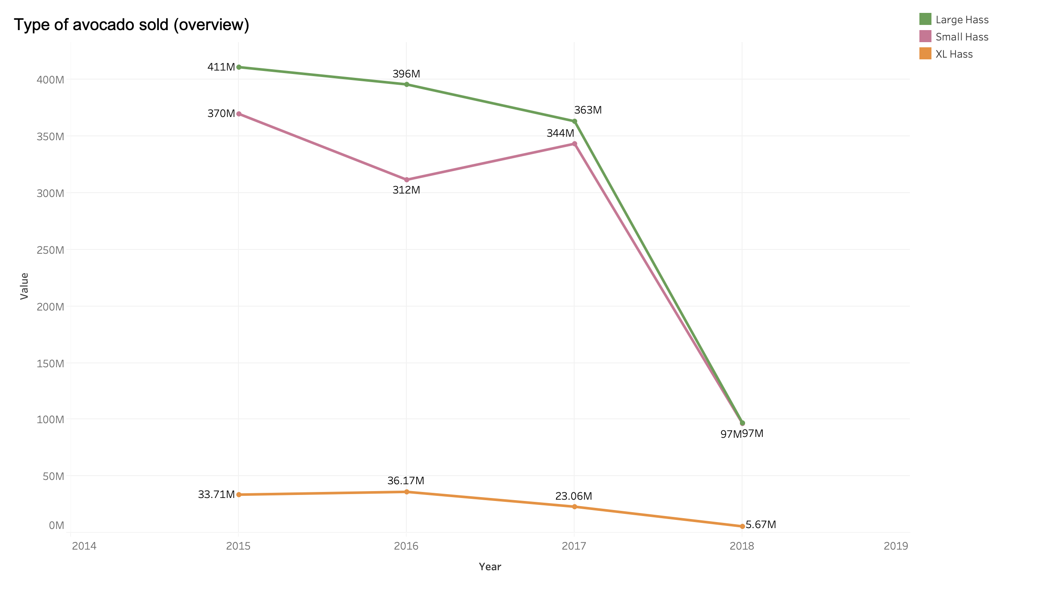
Notes:
Joshua
Total volumn

Slide 9
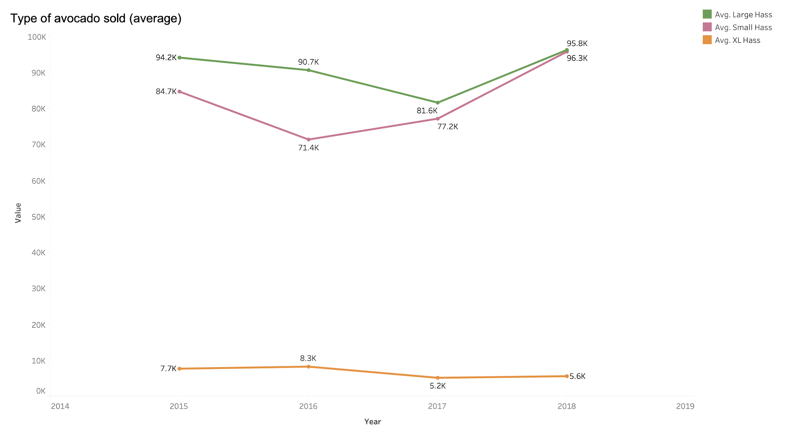
Notes:
Joshua
Average volumn

Slide 10
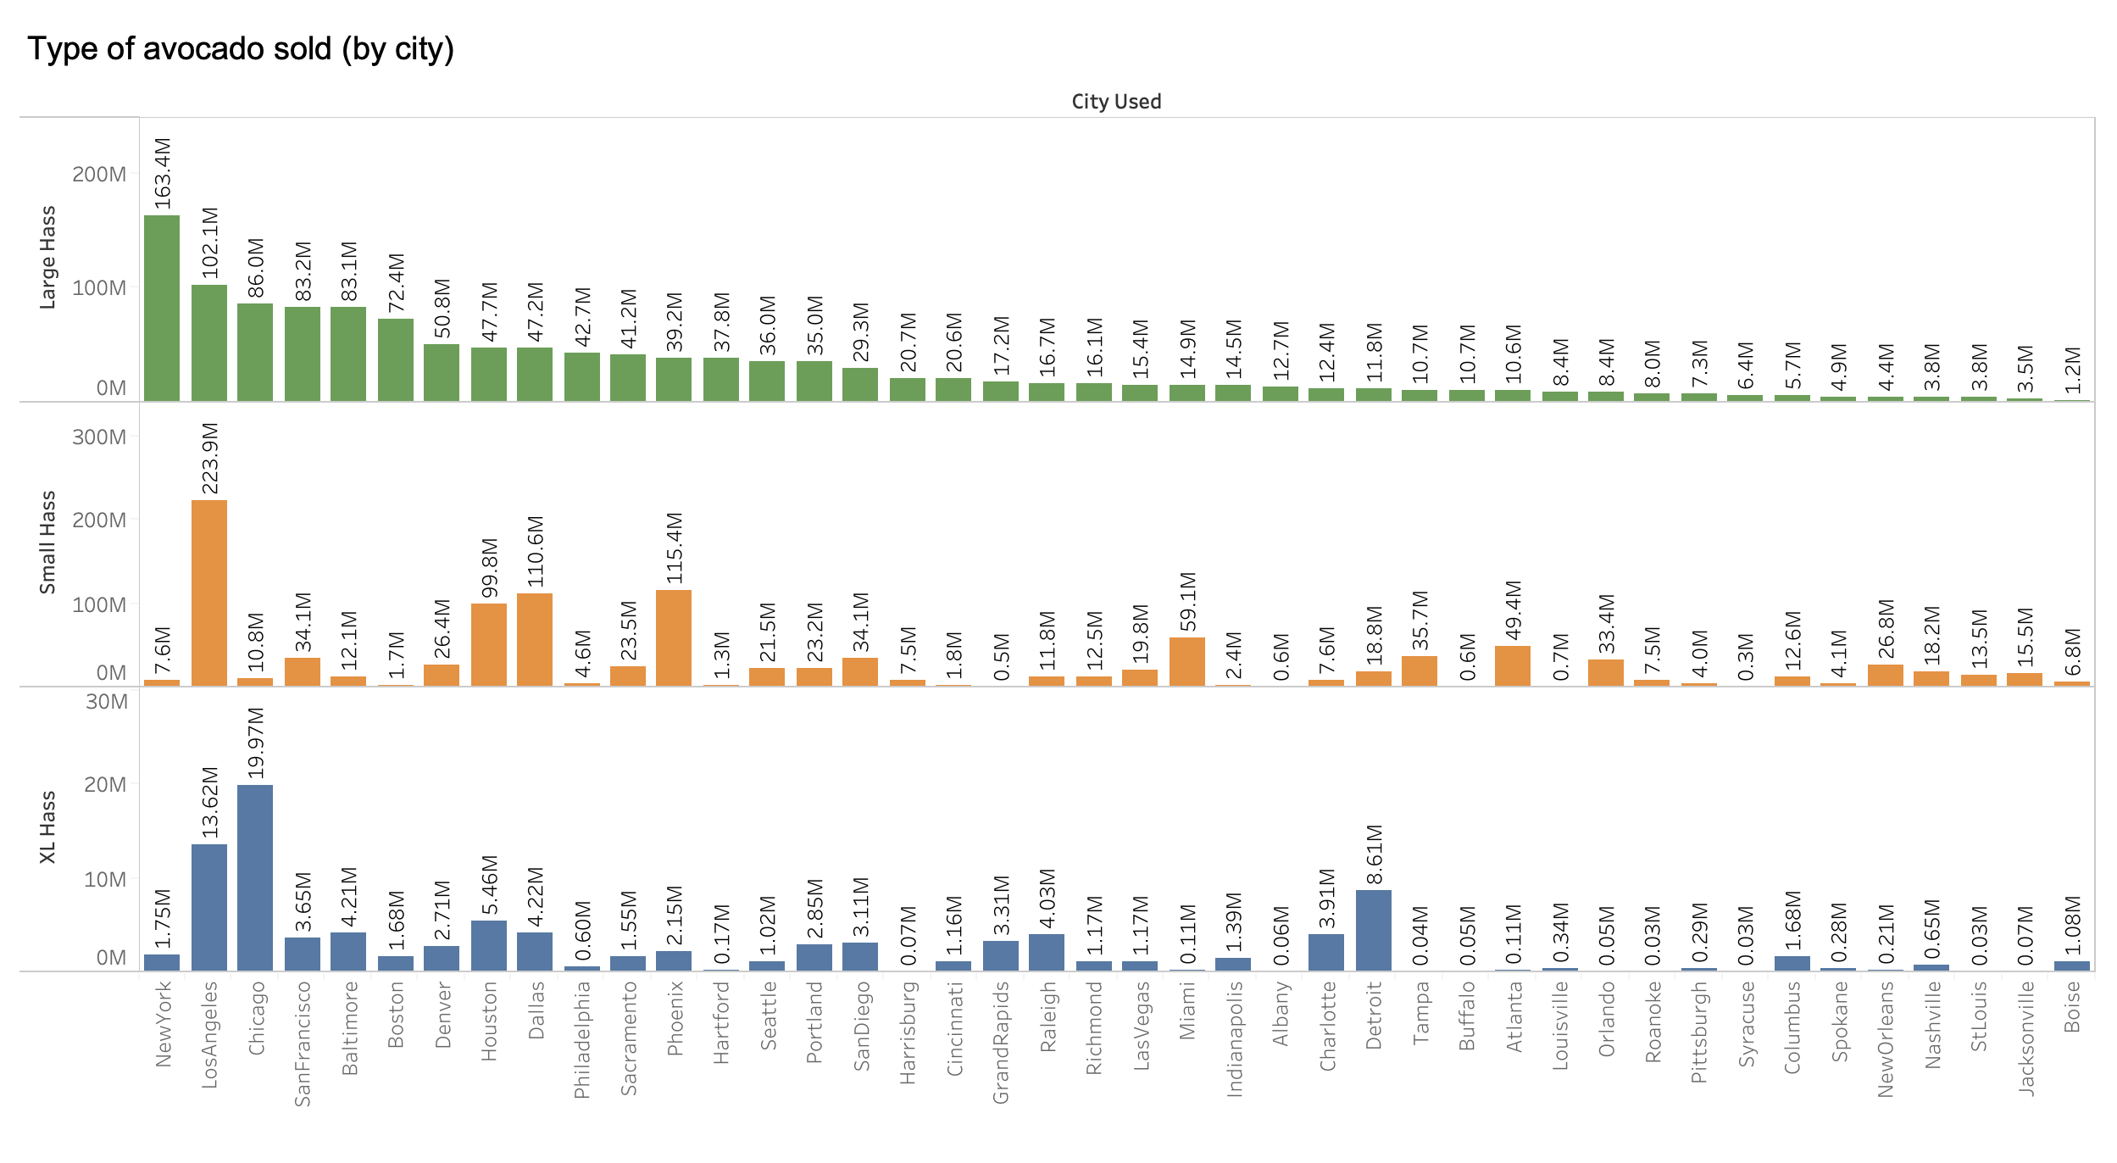
Notes:
Joshua

Slide 11
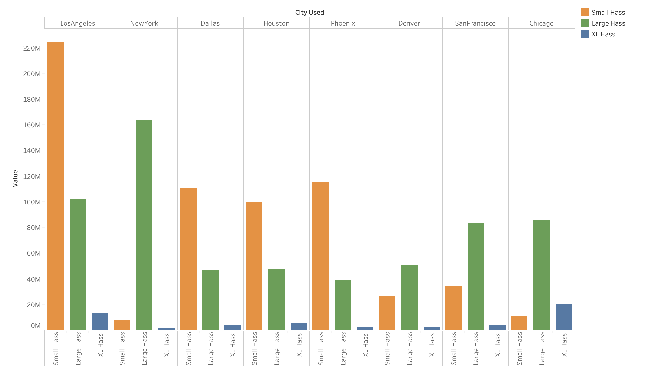
Notes:
Joshua

Slide 12
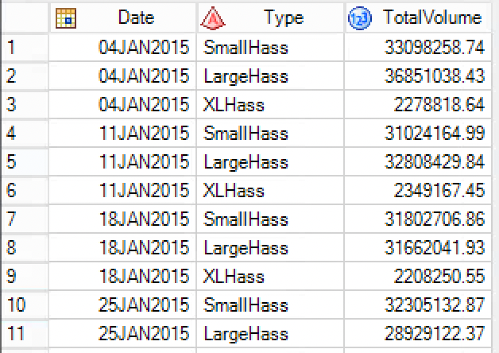
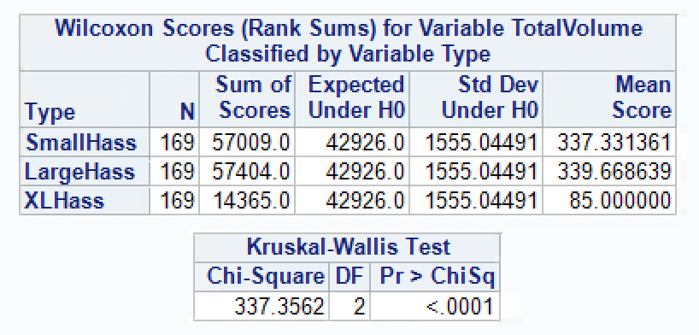
What is the most popular type of avocado?
Notes:
ruyi

Slide 13
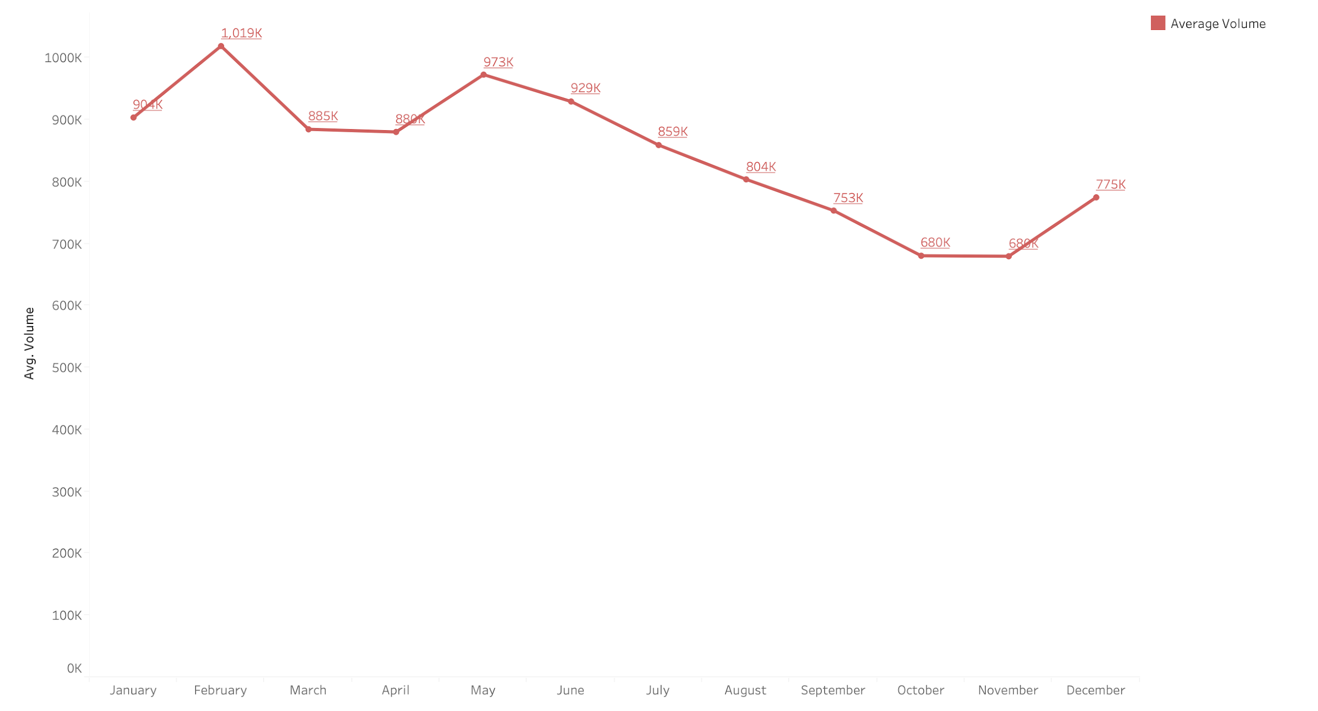
Notes:
ruyi

Slide 14
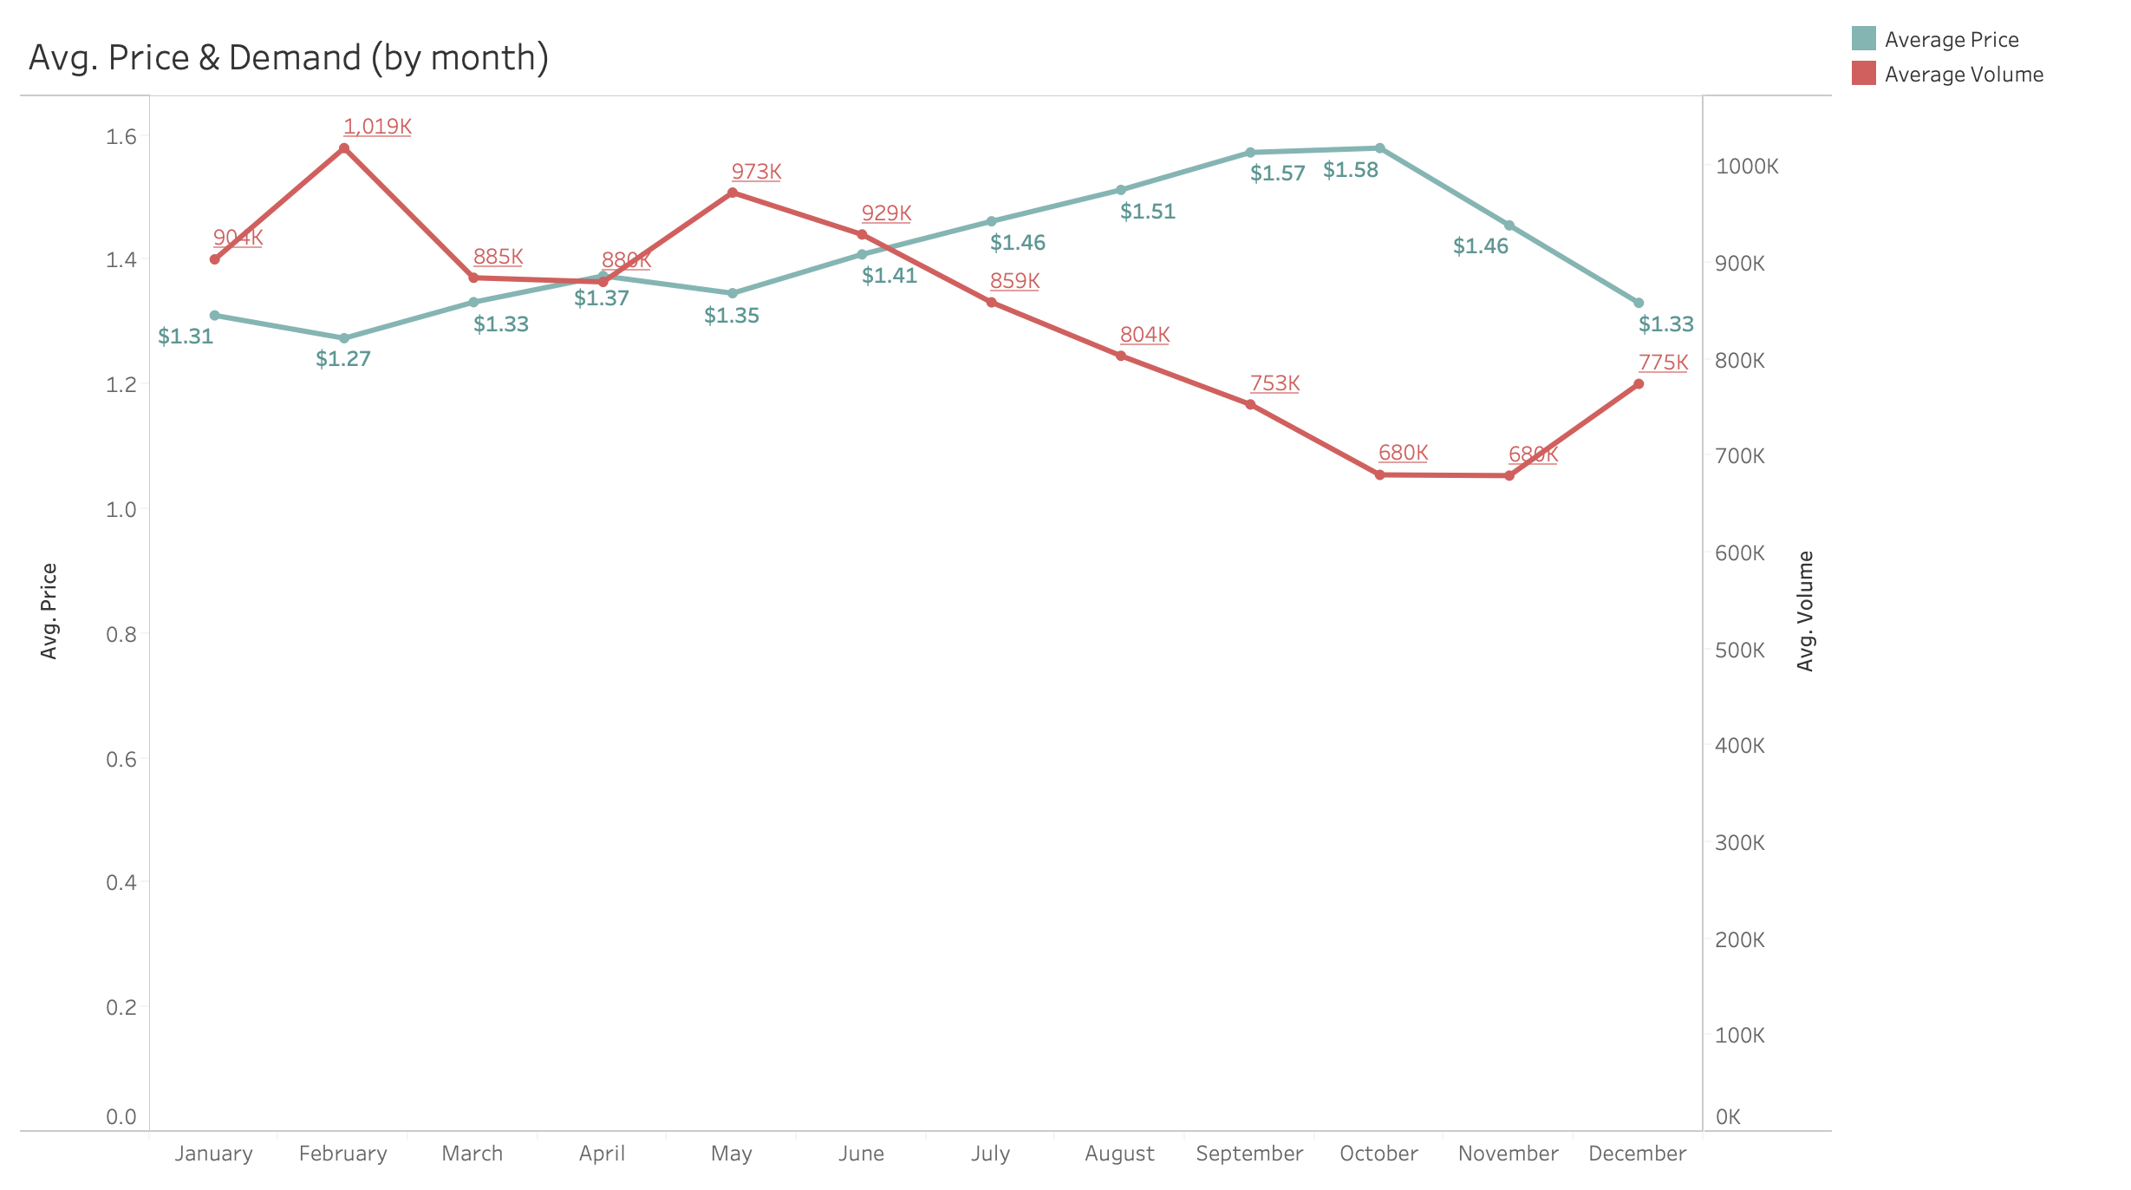
Notes:
ruyi

Slide 15
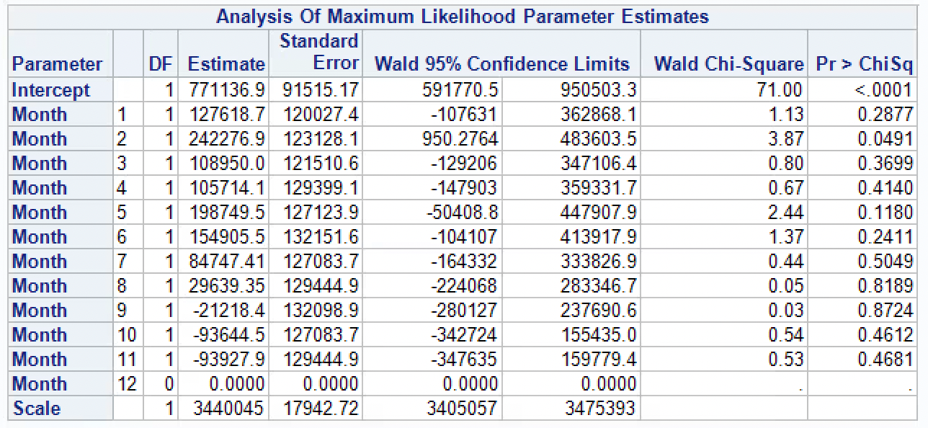
Notes:
ruyi

Slide 16
Notes:
ruyi

Slide 17
Price
Notes:
ruyi

Slide 18
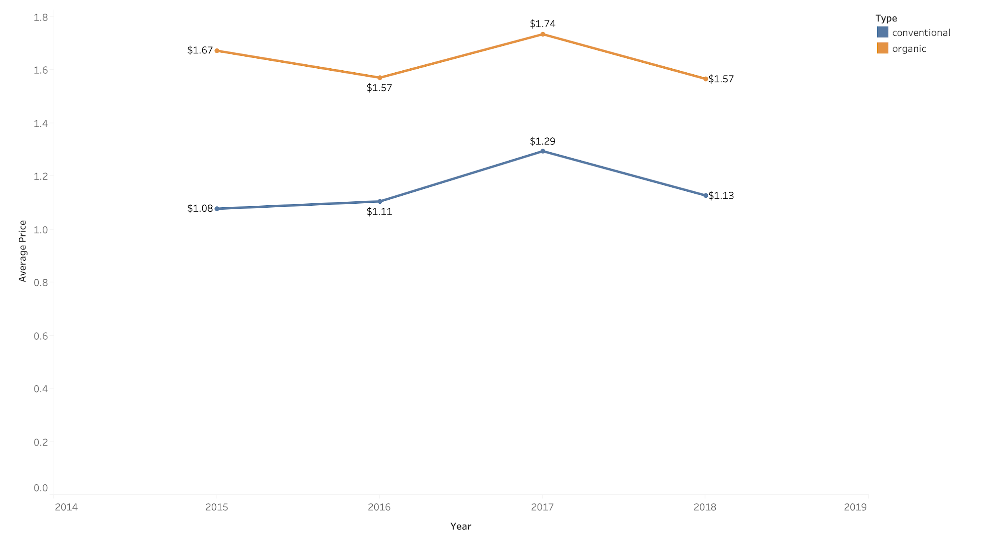
Notes:
ruyi

Slide 19
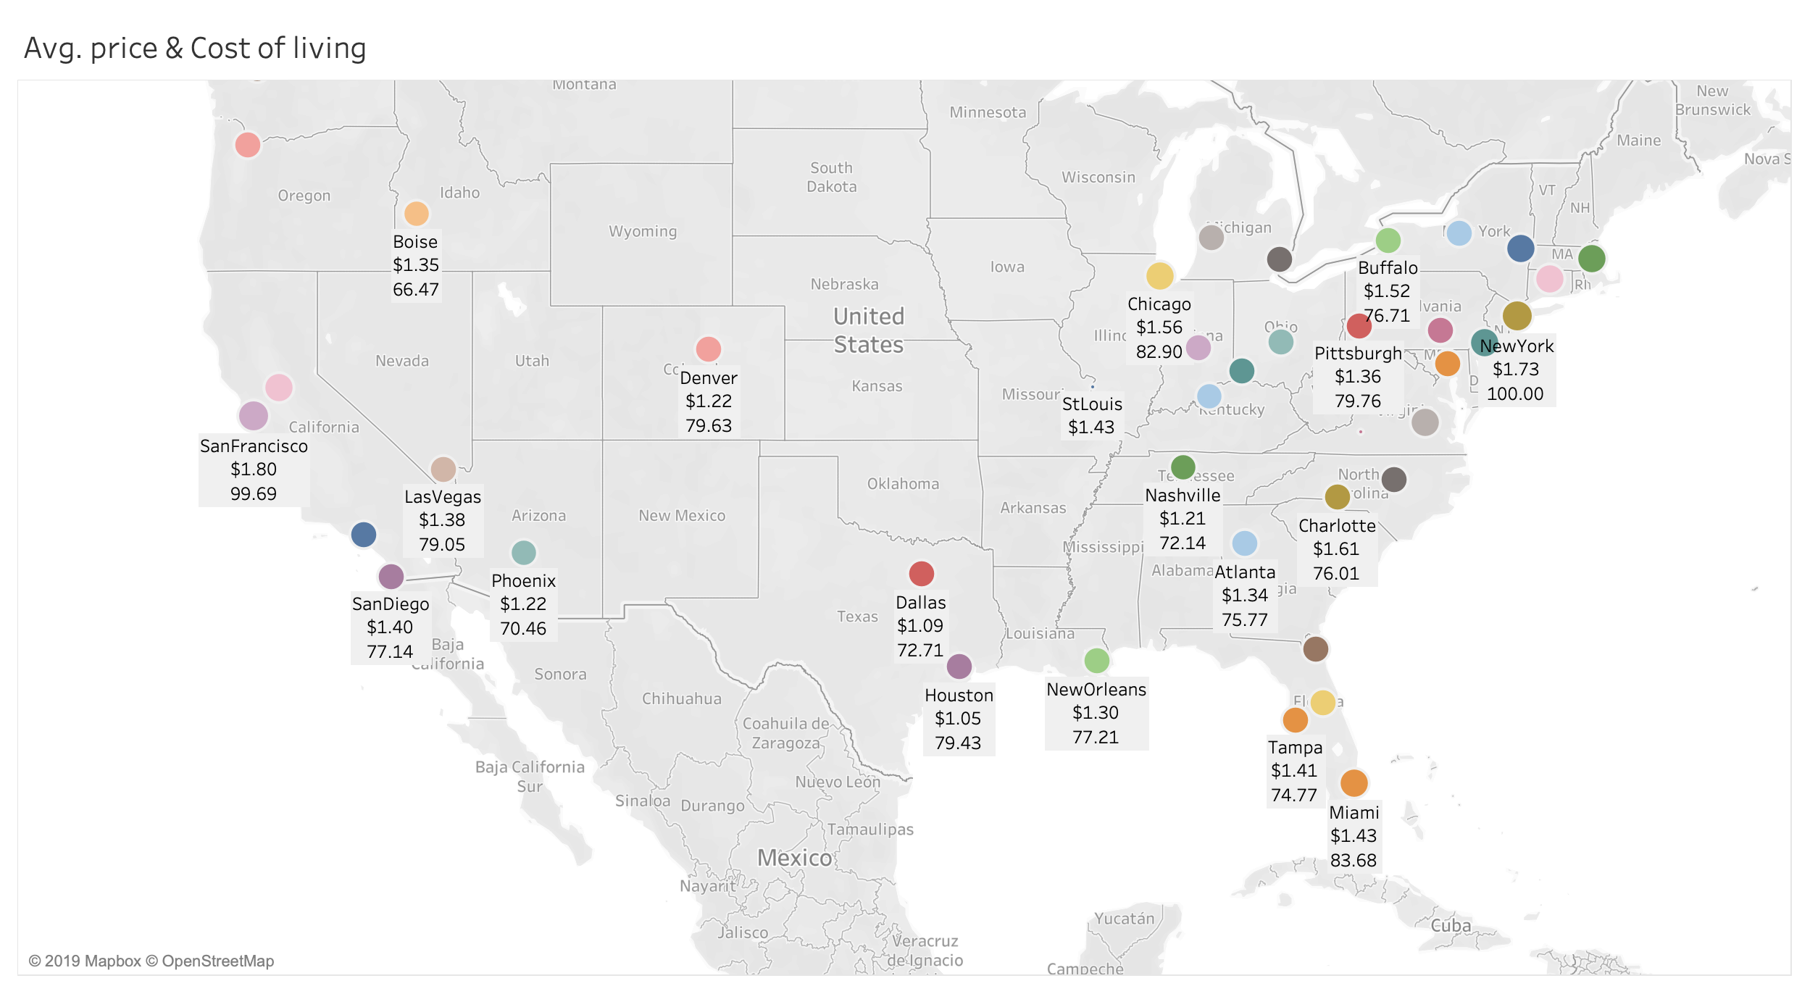
Notes:
ruyi

Slide 20
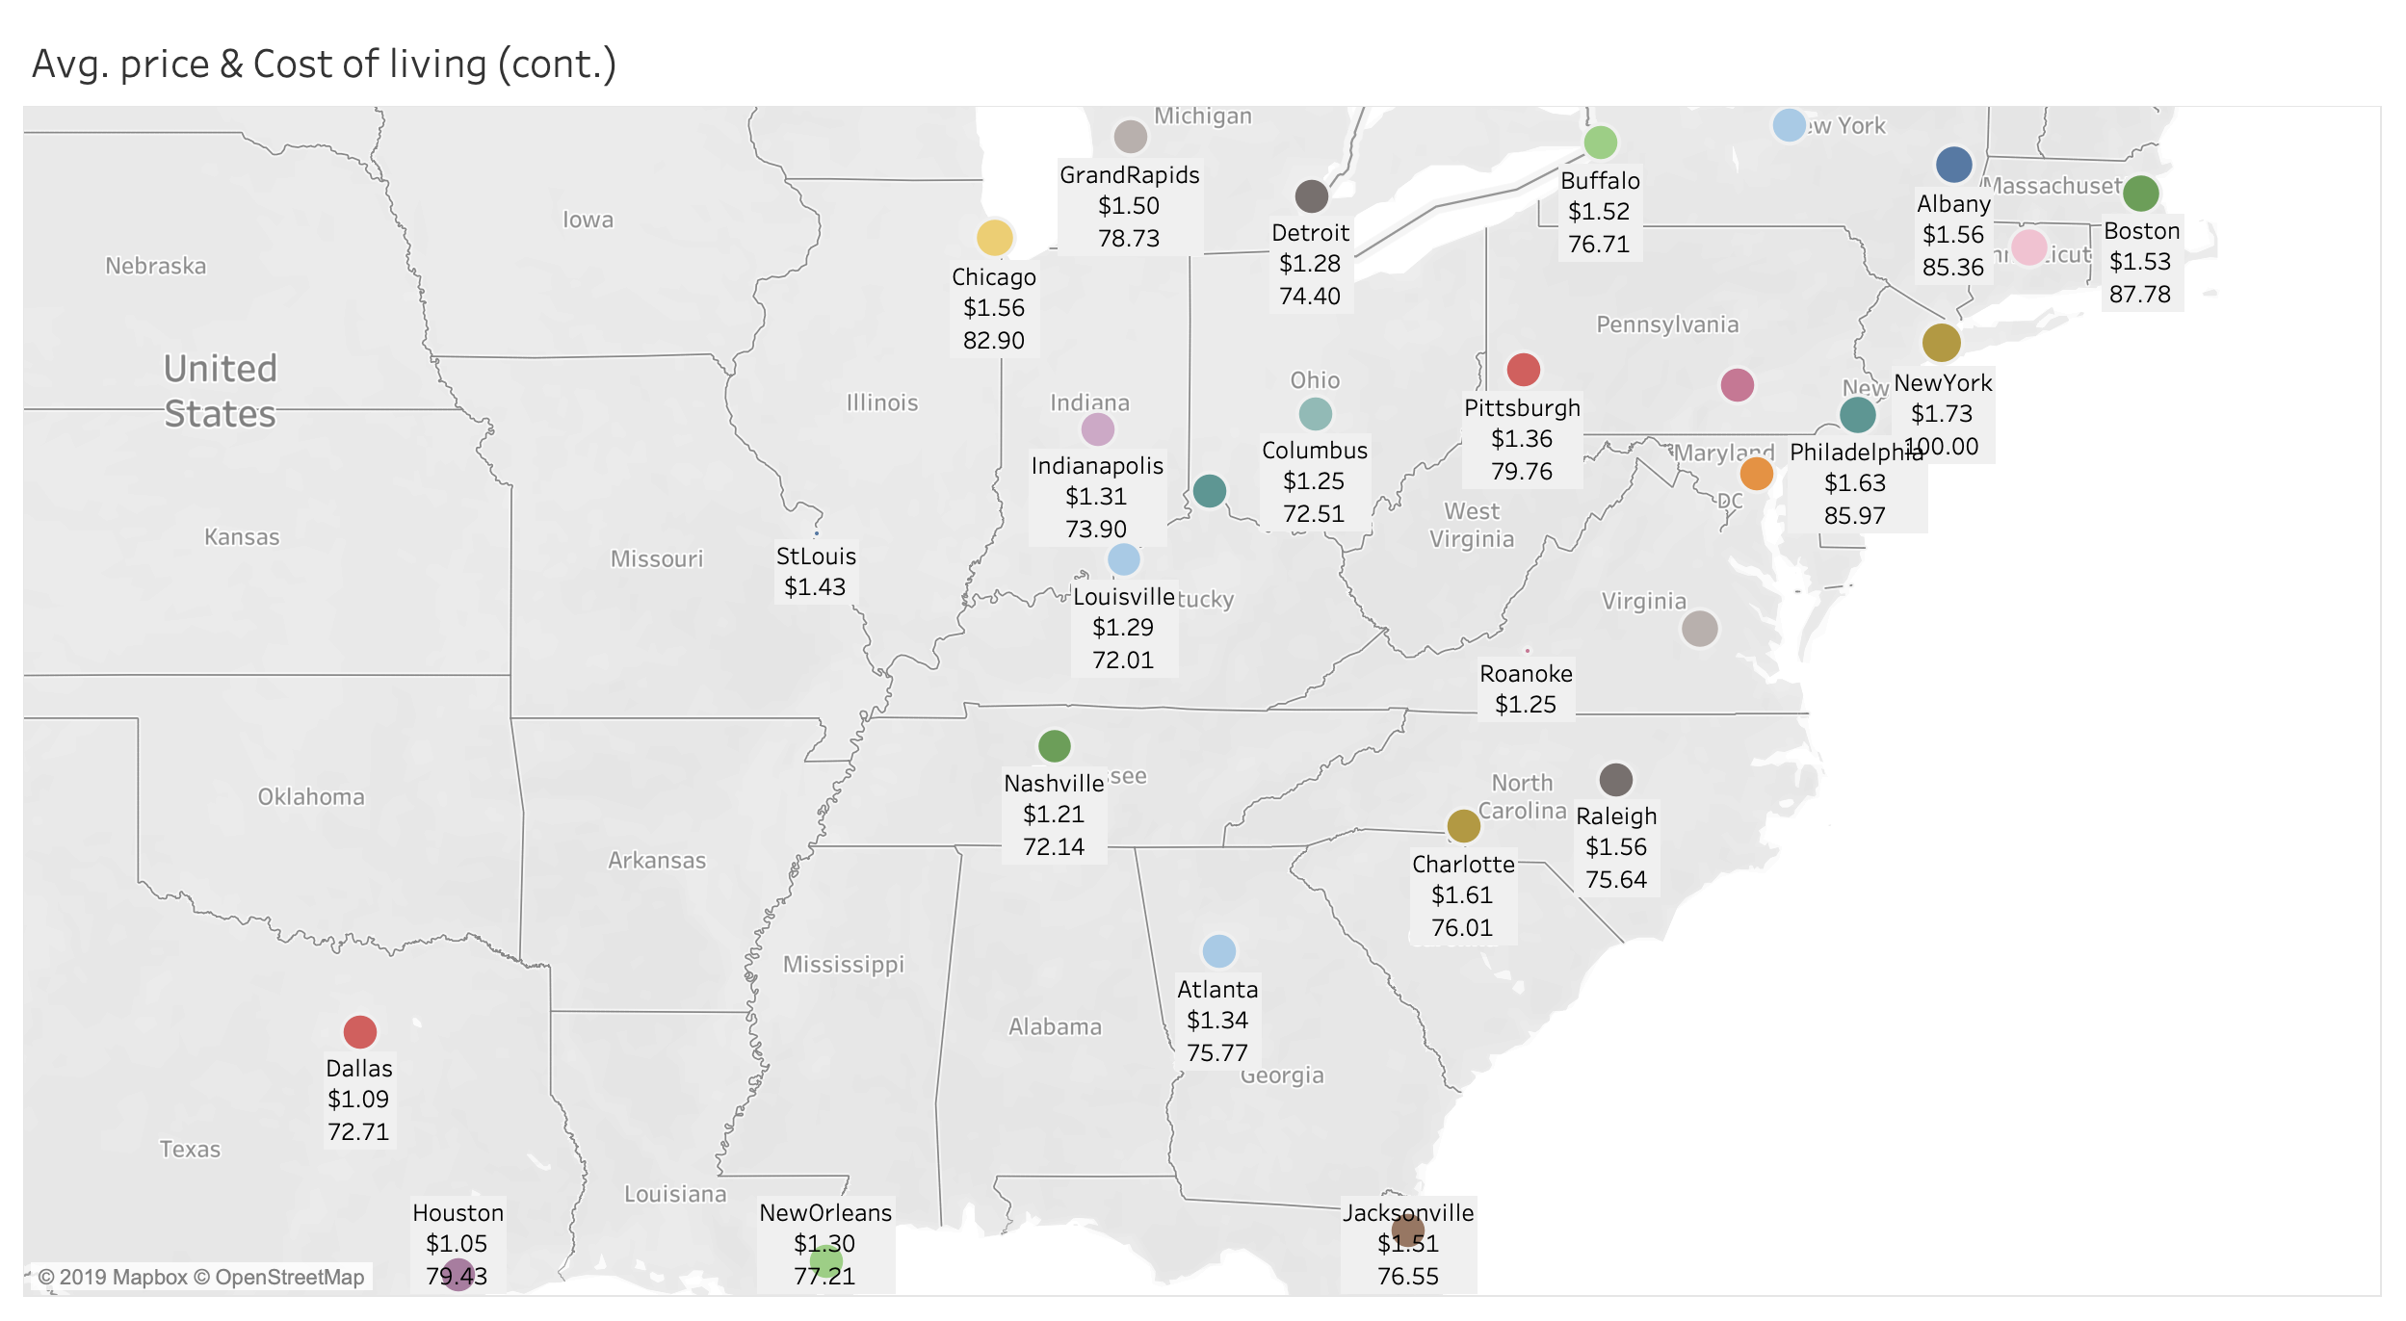
Notes:
ruyi

Slide 21
Time Series Modeling
Transfer Function with ARIMA
Notes:
Ian

Slide 22
Modeling Setup
Independent Variables:
Average Price (In USD)
Dependent Variable:
Average Total Volume Sold
Data: Across the United States
Notes:
Ian

Slide 23
Reality Check
Notes:
Ian

Slide 24
Price
Demand
Notes:
Ian

Slide 25
Price
Demand
Notes:
Ian

Slide 26
Modeling Setup
Independent Variables:
Average Price (In USD) [ Exogenous ]
Dependent Variable:
Average Total Volume Sold
Data: Across the United States
Notes:
Ian

Slide 27
Examine Time Series

Slide 28
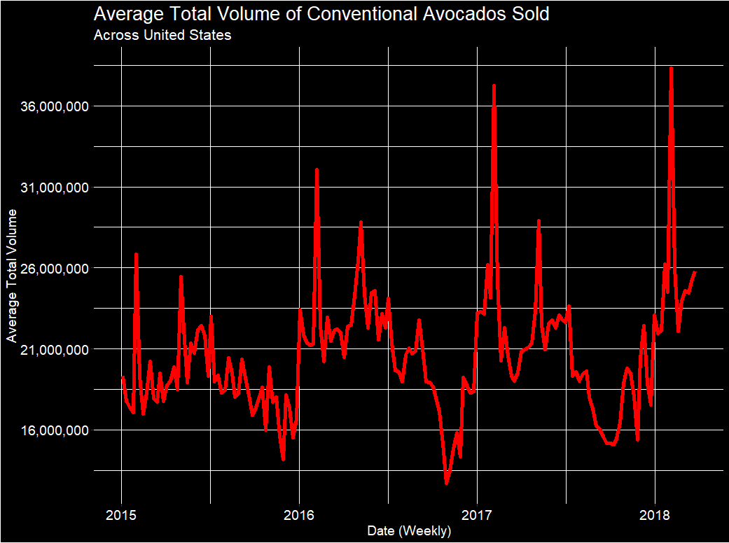
Super Bowl
Cinco de Mayo
July 4th
Notes:
Ian

Slide 29
Modeling Setup
Independent Variables:
Average Price (In USD) [ Exogenous ]
PULSE
Super Bowl, May 5th, July 4th
Dependent Variable:
Average Total Volume Sold
Data: Across the United States
Notes:
Ian

Slide 30
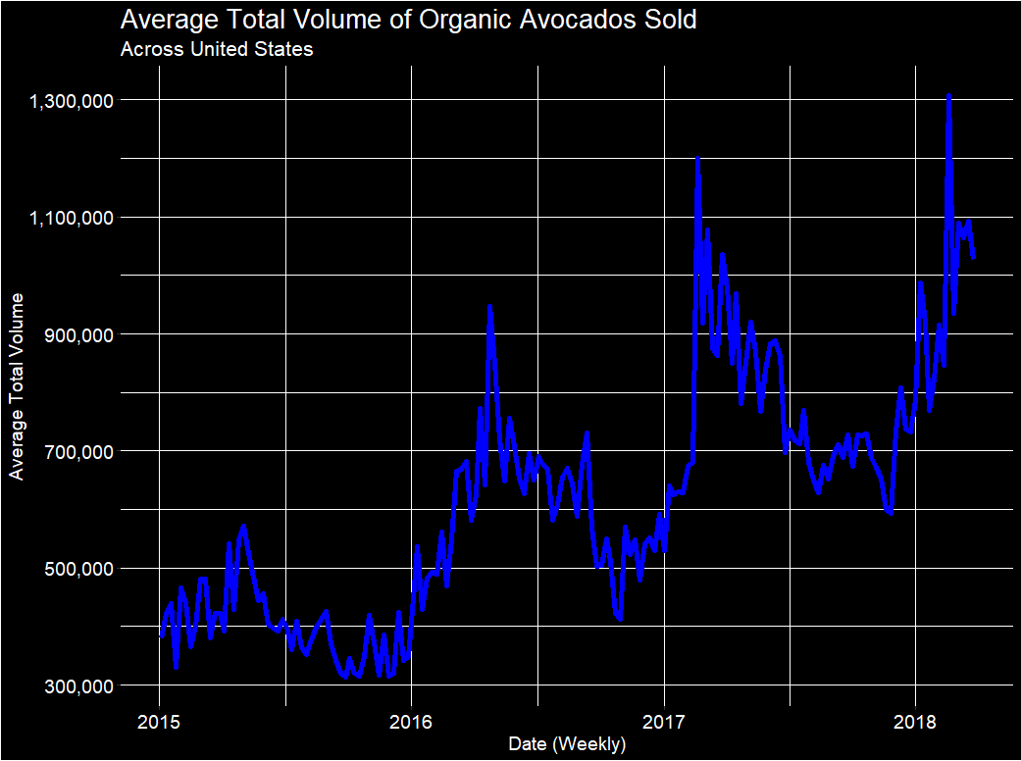
Notes:
Ian

Slide 31
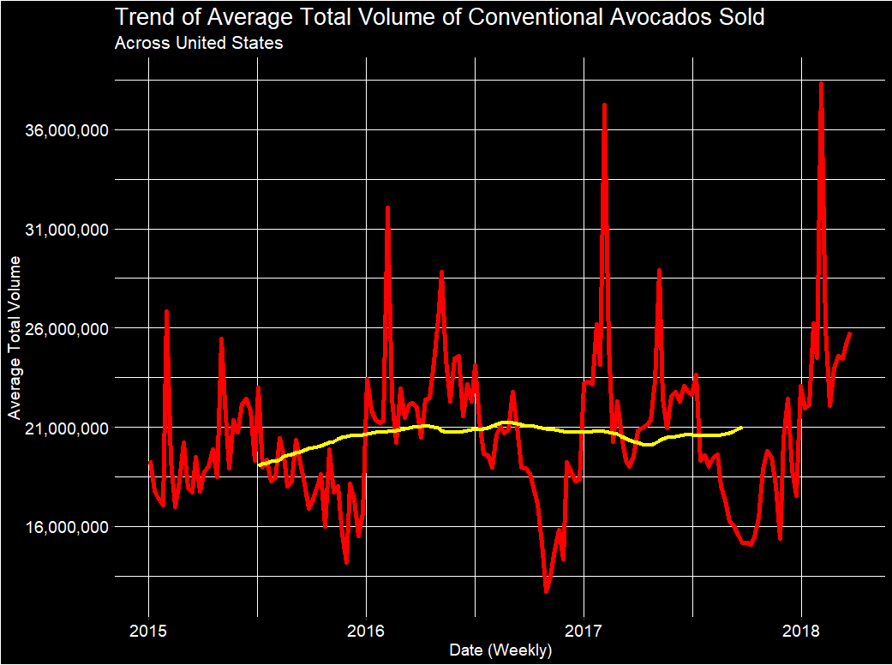
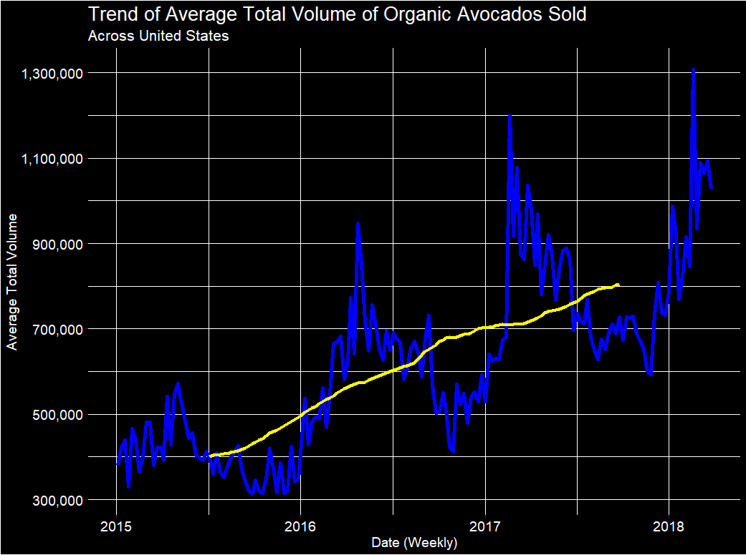
—— Trend
Notes:
Ian
Each also has a Seasonal and Irregular Component

Slide 32
Conventional Avocados
Notes:
Ian

Slide 33
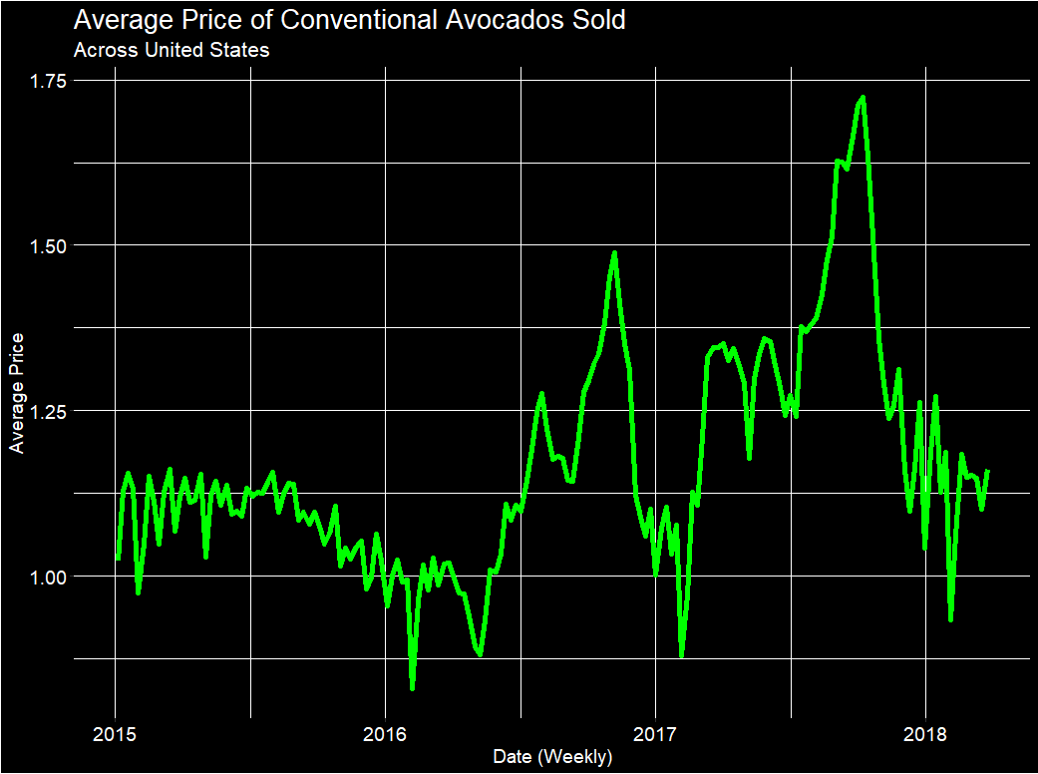
Notes:
Ian

Slide 34
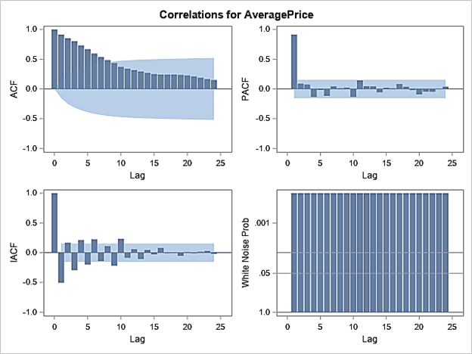
Notes:
Ian

Slide 35
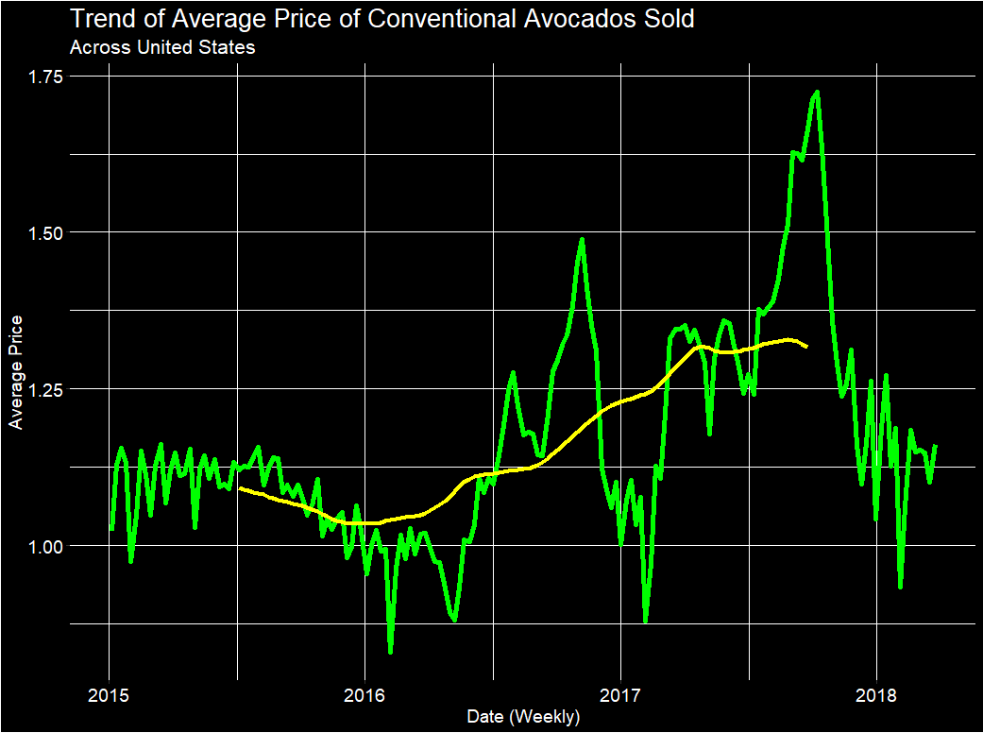
—— Trend
Notes:
Ian
Also has a Seasonal and Irregular Component

Slide 36
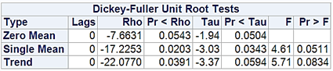
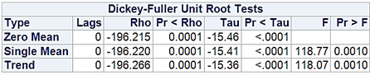
Steps Taken to Prewhiten
Before Differencing
Log Transformation
First Order Differencing
Based off ADF Test
Added 1st Order AR
Added 2nd Order MA
Removed Constant
After Differencing
Notes:
Ian

Slide 37
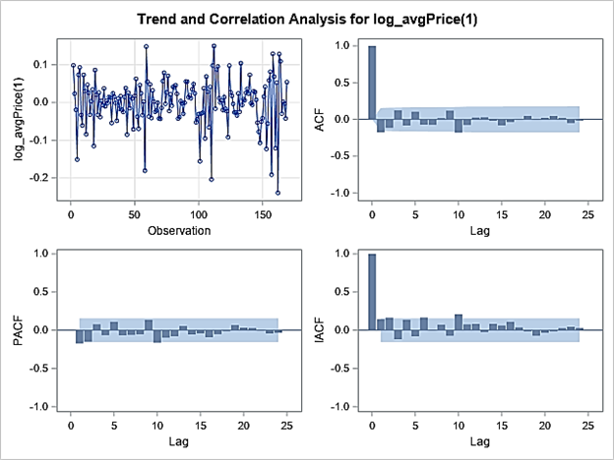
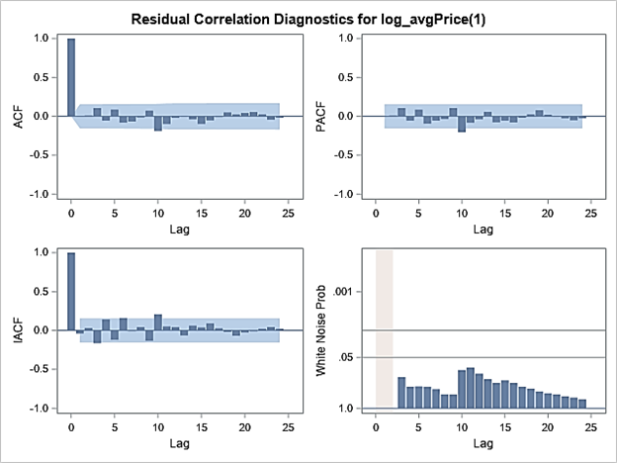
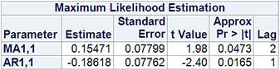
Notes:
Ian

Slide 38
Steps Taken to Fit Transfer Function
Same Transformation on Total Volume
Log Transformation
First Order Differencing
Added 1st and 2nd Order AR
Removed Constant
Examined Cross Correlation Plots
Notes:
Ian

Slide 39
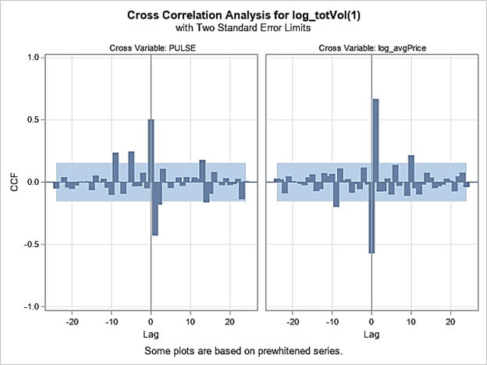
Notes:
Ian

Slide 40
Interpretation:
Log(Average Price) affects Log(Total Volume)(1) at time t = 0 and t = 1.
Build Transfer Function:
First effect is at t = 0.
1 lag between the first effect and the dying down process.
Dying down process is a damped sine wave.
input = (0$(1)/(2)log_avgPrice)
Notes:
Ian

Slide 41
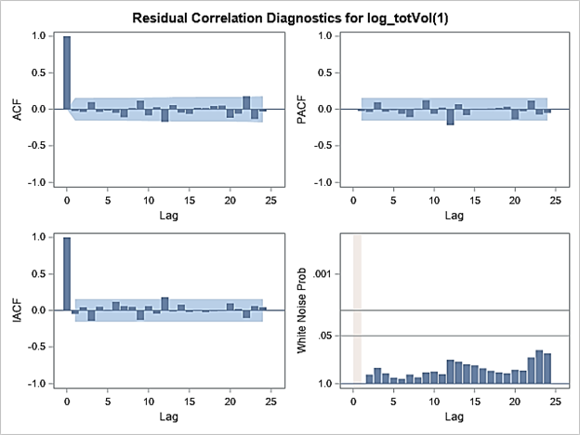
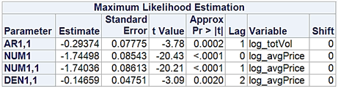
Notes:
Ian

Slide 42
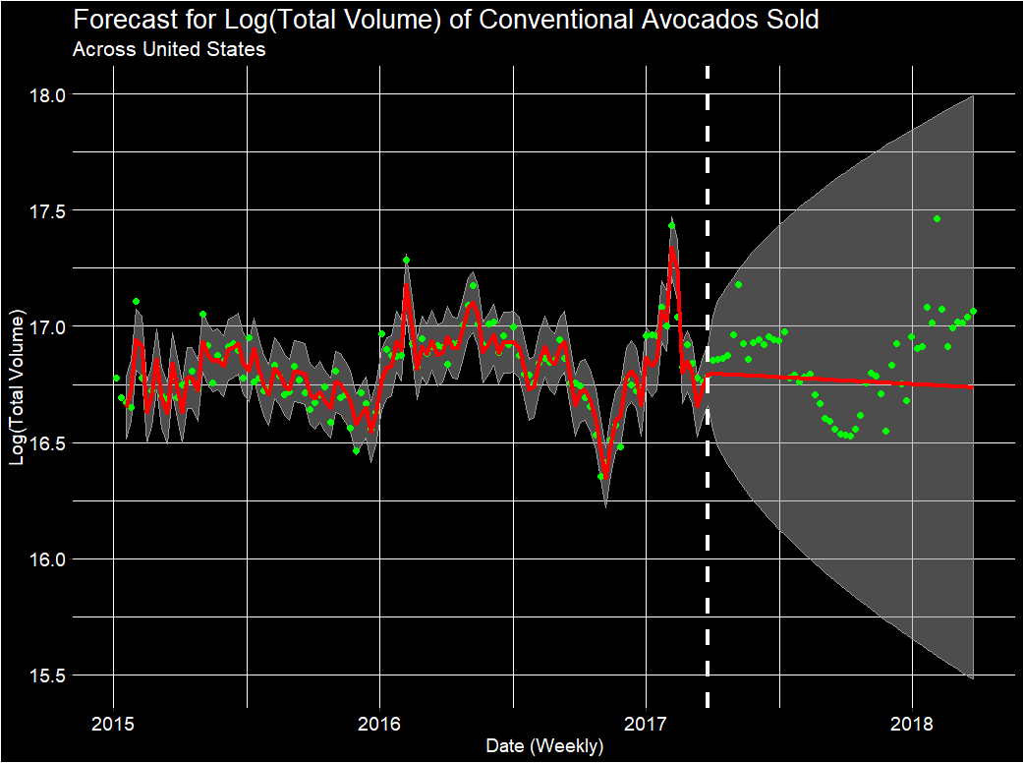
• Real —— Fitted ■ 95% CI
Notes:
Ian

Slide 43
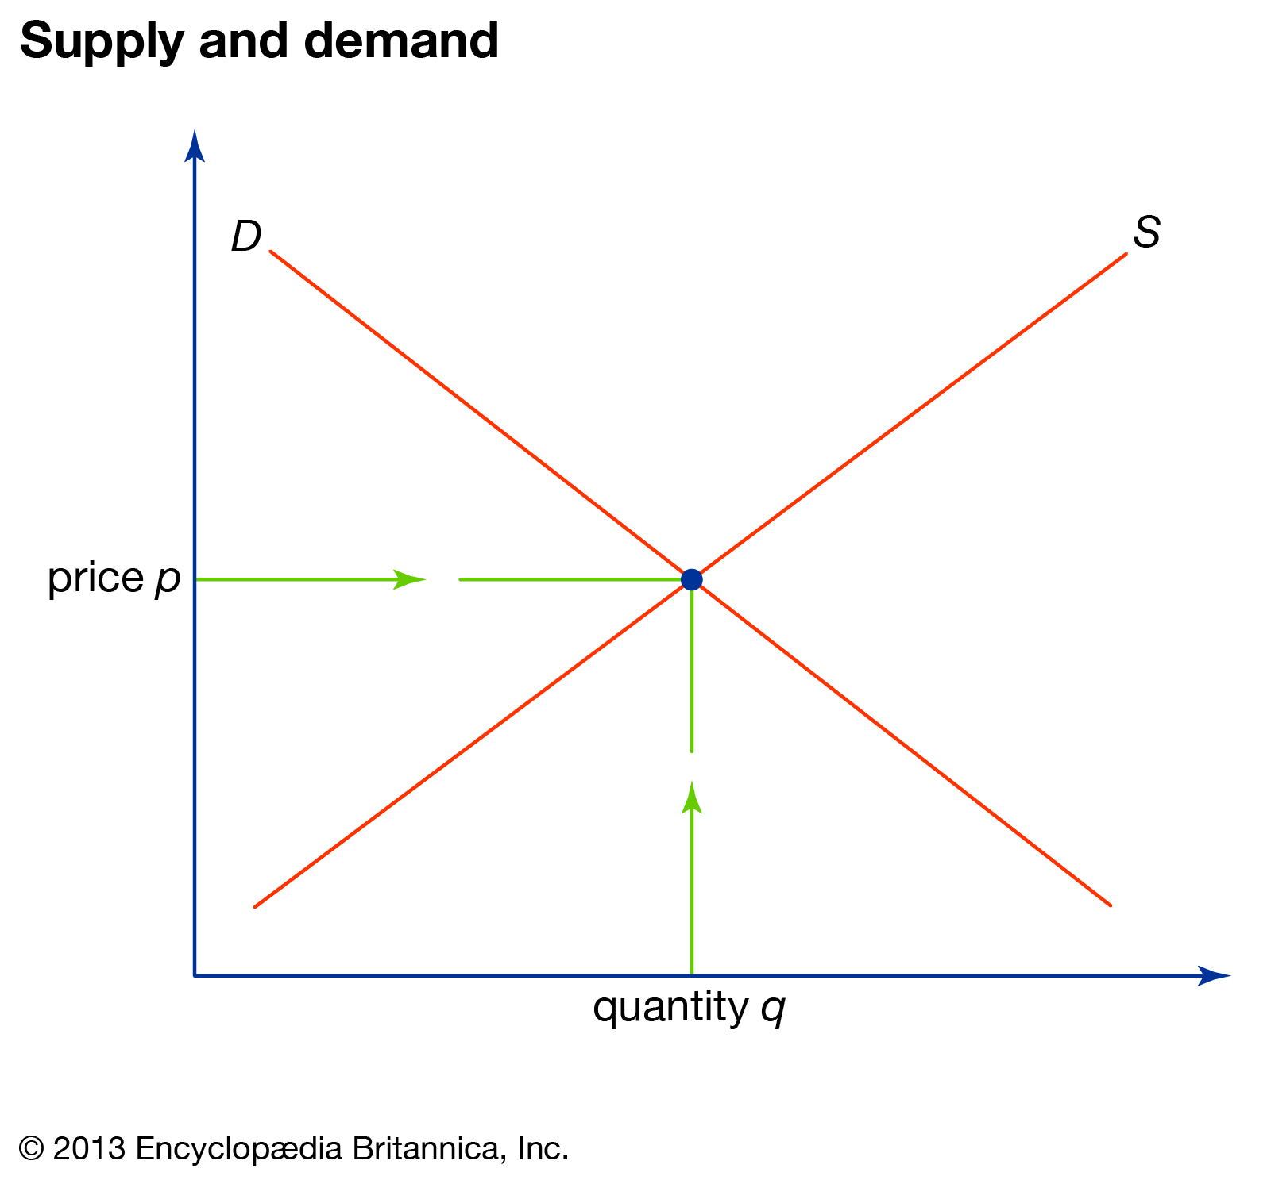
What’s Wrong?
Missing variables that provide more information in predicting Total Volume.
Supply would probably help.
Supply indirectly affects demand through price.
Notes:
Ian

Slide 44
Total Revenue ARIMA
With PULSE
Notes:
Allison
Since the transfer function didn’t work, we still wanted to use ARIMA in some useful way, so next we focused on Total Revenue.
We still included our pulse variable in model building.

Slide 45
Conventional Avocado Model
Log(Total Revenue)
ARIMA (1, 1, 1) (0, 1, 0)₅₂
No Constant
Notes:
Allison
We started by building an ARIMA model for conventional avocados.
The response for this model is the Log(Total Revenue)
This model contains a first-order AR term, Difference, and MA term. As well as a first order seasonal difference (Diff of 52, weekly data)
Finally, the constant term of the model was dropped.

Slide 46
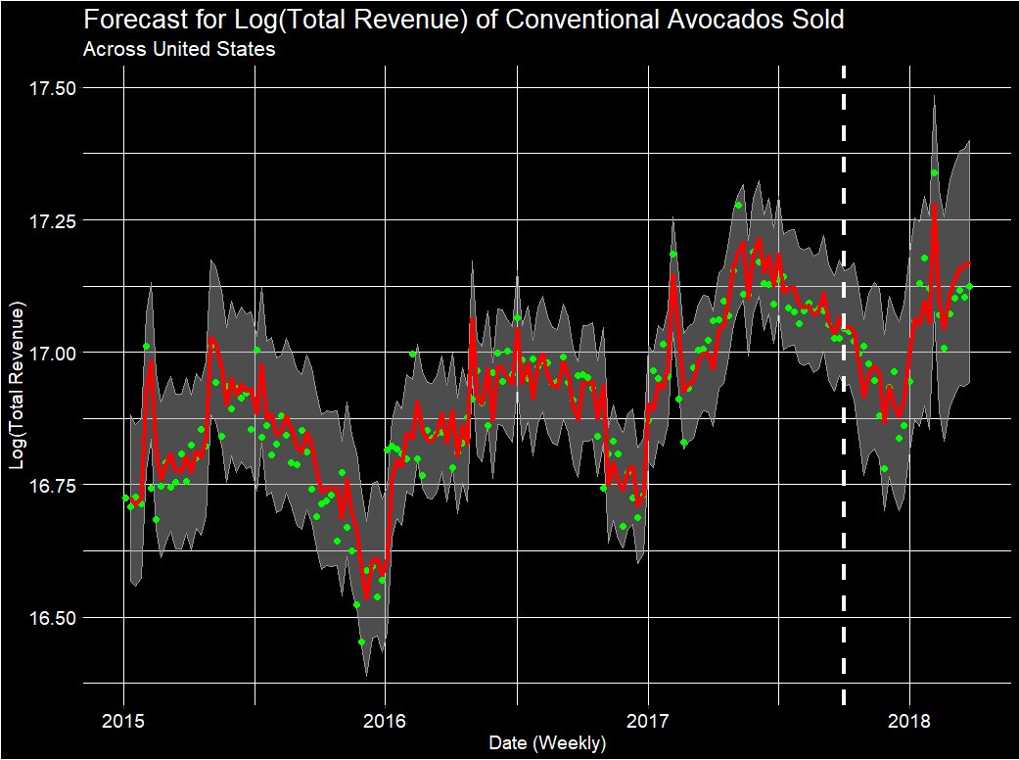
• Real —— Fitted ■ 95% CI
Notes:
Allison
Using this model, we get this plot.
The fitted line follows the training data pretty decently.
However, its starts to struggle a little bit with predictions.
In addition, the confidence intervals are a bit large.

Slide 47
Organic Avocado Model
Log(Total Revenue)
ARIMA (0, 1, 1) (0, 1, 0)₅₂
No Constant
Notes:
Allison
Next, we built a model for total revenue using Organic avocados.
The output again is Log(Total Revenue).
This model is similar to the conventional avocado model, but this time the first-order AR term was dropped.

Slide 48
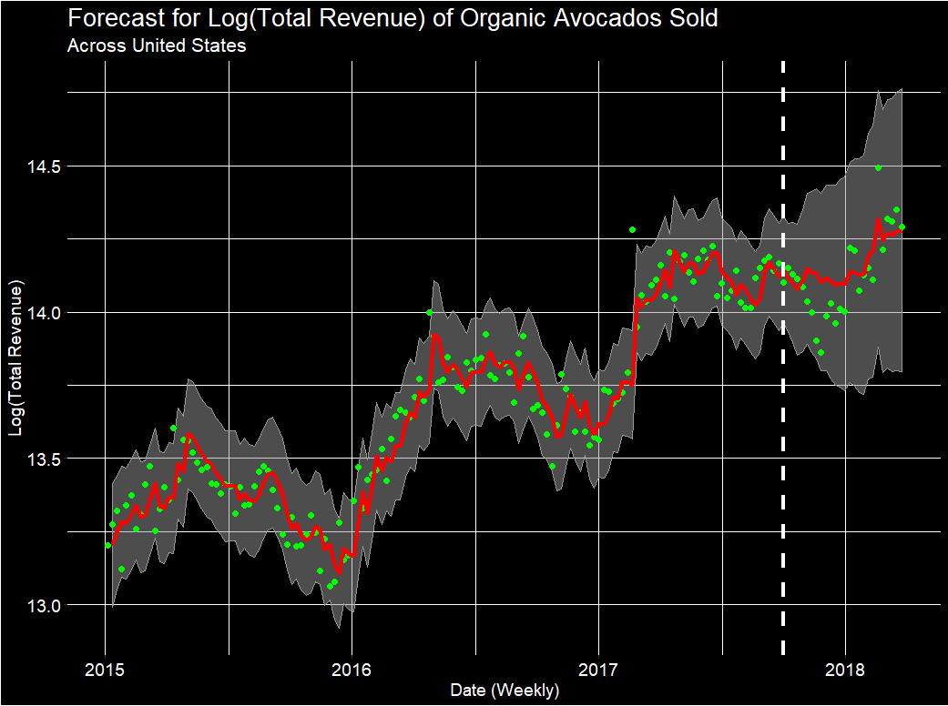
• Real —— Fitted ■ 95% CI
Notes:
Allison
Using this model, we get this plot.
The fitted line follows the training data pretty decently.
However, its starts to struggle a little bit with predictions.
In addition, the confidence intervals are a bit large, and get larger when we predict

Slide 49
Unobserved Components Model
Notes:
Ian

Slide 50
Conventional Avocado Model Setup
Average Price is Deterministic
Level is Deterministic
Slope is Deterministic
Irregular falls into the “weird” category
Season is Deterministic
Notes:
Ian

Slide 51
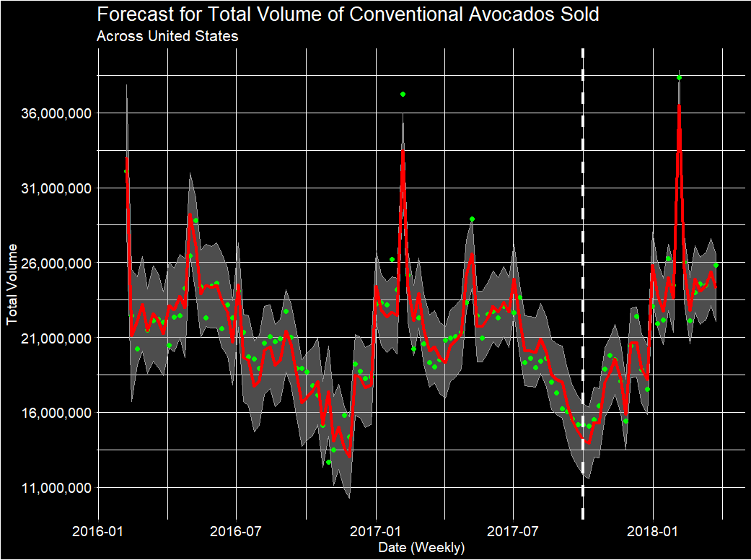
• Real —— Fitted ■ 95% CI
Notes:
Ian

Slide 52
Organic Avocado Model Setup
Log(Total Volume), Log(Average Price)
Log(Average Price) is Deterministic
Level is Deterministic and Stochastic
Slope was Removed
Irregular falls into the “weird” category
Season is Deterministic
Notes:
Ian

Slide 53
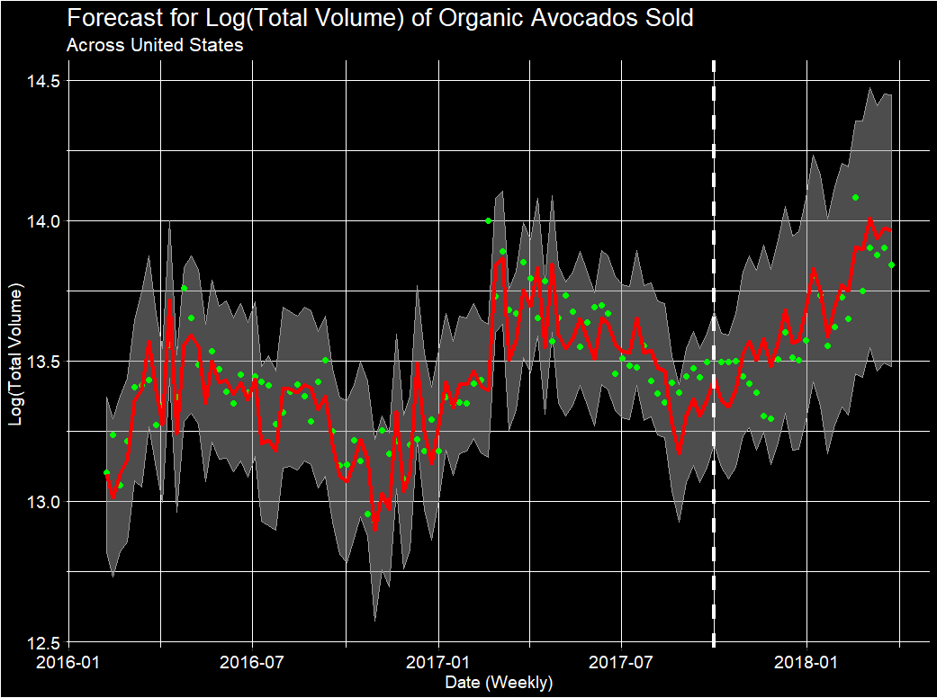
• Real —— Fitted ■ 95% CI
Notes:
Ian
It seems that organic is much harder to model.

Slide 54
Conclusion
Where are the most avocados sold & where are avocados most expensive on average?
Depends on the population
Location & Cost of living
What is the most popular type of avocado sold?
Large hass overall
In which months is demand higher/lower?
February & May (high)
October & November (low)
What will the future demand and price be?
Have demonstrated that Demand and Total Revenue can be modeled and predicted.
Notes:
Allison
Whys:
Q1: Avocado providers can identify where the majority of profits are coming from and where demand is higher.
Q2: Know what type of avocado to prioritize.
Q3: Helps providers strategize their logistics before and after harvesting.
Q4: Better enable avocado providers to maximize revenue and improve budget planning.

Slide 55
Recommendations
Ensure supply meets demand during peak seasons for max profit:
February (Super Bowl) and May (Cinco de Mayo)
For a new provider/grower:
Consider growing conventional avocados
More profitable than organic.
For current and new provider/grower:
Large hass mkt - New York, Chicago
Small hass mkt - Los Angeles, Phoenix
Topics for Future Study
Expand modeling to geographic areas and specific cities.
Refine Total Revenue models.
Figure out how to model the feedback loop between price and demand.
Include supply data.
Notes:
Allison

Slide 56
Questions?
Notes:
Allison

